Slide 1
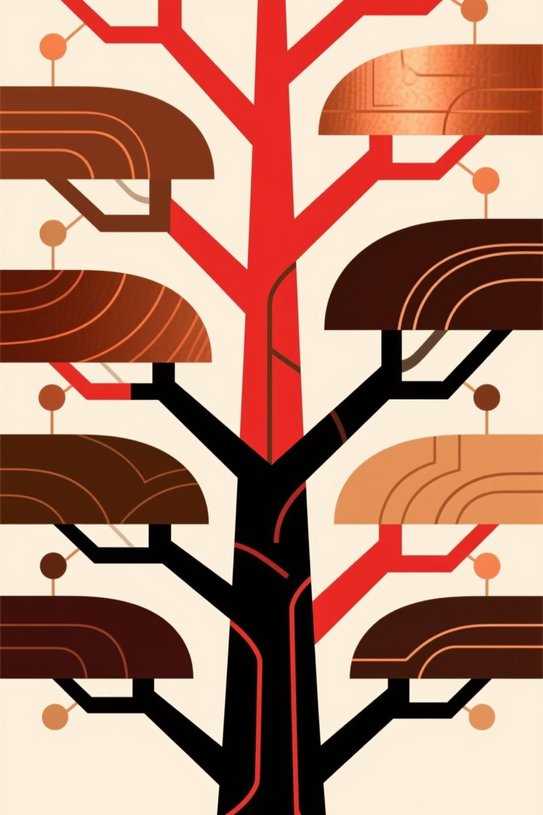
Understanding Red-Black Trees: A Deep Dive into Balanced Data Structures
Red-Black Trees are fundamental in computer science, offering a robust solution for maintaining balanced binary search trees. This presentation will explore their core concepts, properties, the crucial insertion algorithm, and their significance in ensuring efficient data operations.

Slide 2

What is a Red-Black Tree?
A Red-Black Tree is a special type of self-balancing binary search tree. Unlike a regular binary search tree, it guarantees that its height remains logarithmic, preventing worst-case scenarios that can degrade performance.
It uses a simple coloring scheme (red or black) for its nodes to maintain balance.
This self-balancing mechanism ensures that operations like search, insertion, and deletion are highly efficient.
Efficiency Guaranteed
The tree's height is always at most 2 \times \log(n+1), where n is the number of nodes.
This structural integrity guarantees an optimal O(log n) time complexity for all major operations.

Slide 3
Key Properties of Red-Black Trees
Red-Black Trees adhere to a strict set of rules that govern their structure and coloring, ensuring their self-balancing nature. Violations of these rules trigger specific rebalancing operations.
Root is Black
No Consecutive Reds
The root node of a Red-Black Tree is always colored black. This is a foundational rule that helps in maintaining the black-height property across all paths.
A red node cannot have red children. If a node is red, both of its direct children (if they exist) must be black. This rule is crucial for preventing imbalances caused by too many red nodes in a path.
Consistent Black Height
Null Leaves are Black
Every path from any given node down to any of its null leaves must contain the same number of black nodes. This property, known as "black-height," is the most complex but essential for ensuring the tree's balance.
All null leaves (or NIL nodes), which represent the absence of a child, are considered black. This simplifies the application of the black-height property.

Slide 4



Why Use Red-Black Trees?
Red-Black Trees offer a compelling balance between strict structural constraints and operational efficiency, making them a preferred choice for many applications.
Maintained Balance
Fast Operations
Dynamic Adjustment
They maintain a balanced tree structure without the overly rigid balancing requirements of some other self-balancing trees like AVL trees, leading to simpler implementations and faster average-case performance.
All core operations—insertion, deletion, and lookup—are guaranteed to complete in O(log n) time, providing predictable and high performance even with large datasets.
The tree dynamically adjusts its structure using color changes and rotations whenever an insertion or deletion occurs. These rebalancing acts are efficient and preserve the Red-Black Tree properties.
Red-Black Trees are widely used in practical applications, including associative arrays, database indexing, and the implementation of data structures like std::map and std::set in C++.

Slide 5
Insertion Algorithm in Red-Black Trees
Inserting a new node into a Red-Black Tree involves a series of steps to ensure that all Red-Black properties are maintained. The process starts by treating the new node similarly to a standard Binary Search Tree insertion.
01
02
Initial Insertion
Root Check
Insert the new node into the tree as if it were a standard binary search tree. Always color this new node red. This initial coloring often creates a temporary violation of the Red-Black properties, which will be fixed in subsequent steps.
If the newly inserted node happens to be the root of the tree, simply recolor it black. A single node tree or a root node must always be black according to the properties.
03
04
Parent Color Check
Red Parent, Red Uncle
If the parent of the new node is black, no Red-Black property is violated (specifically, the "no two consecutive reds" rule), and the insertion process is complete.
If the parent is red and the new node's uncle (the other child of the grandparent) is also red: recolor the parent and uncle black, and the grandparent red. Then, repeat the checking process starting from the grandparent, as it might have created a new violation with its own parent.
05
06
Red Parent, Black/Null Uncle (Rotations)
Final Root Recolor
If the parent is red and the uncle is black or null, perform rotations (LL, LR, RR, RL cases) to fix the violation. These rotations re-orient the nodes to restore balance. After the rotation, recolor specific nodes (usually the former parent or grandparent) to maintain the properties, often making the new root of the rotated subtree black and its children red.
Always ensure that the root of the entire tree remains black after all rebalancing operations are complete. This is a fail-safe to guarantee the first Red-Black property.

Slide 6
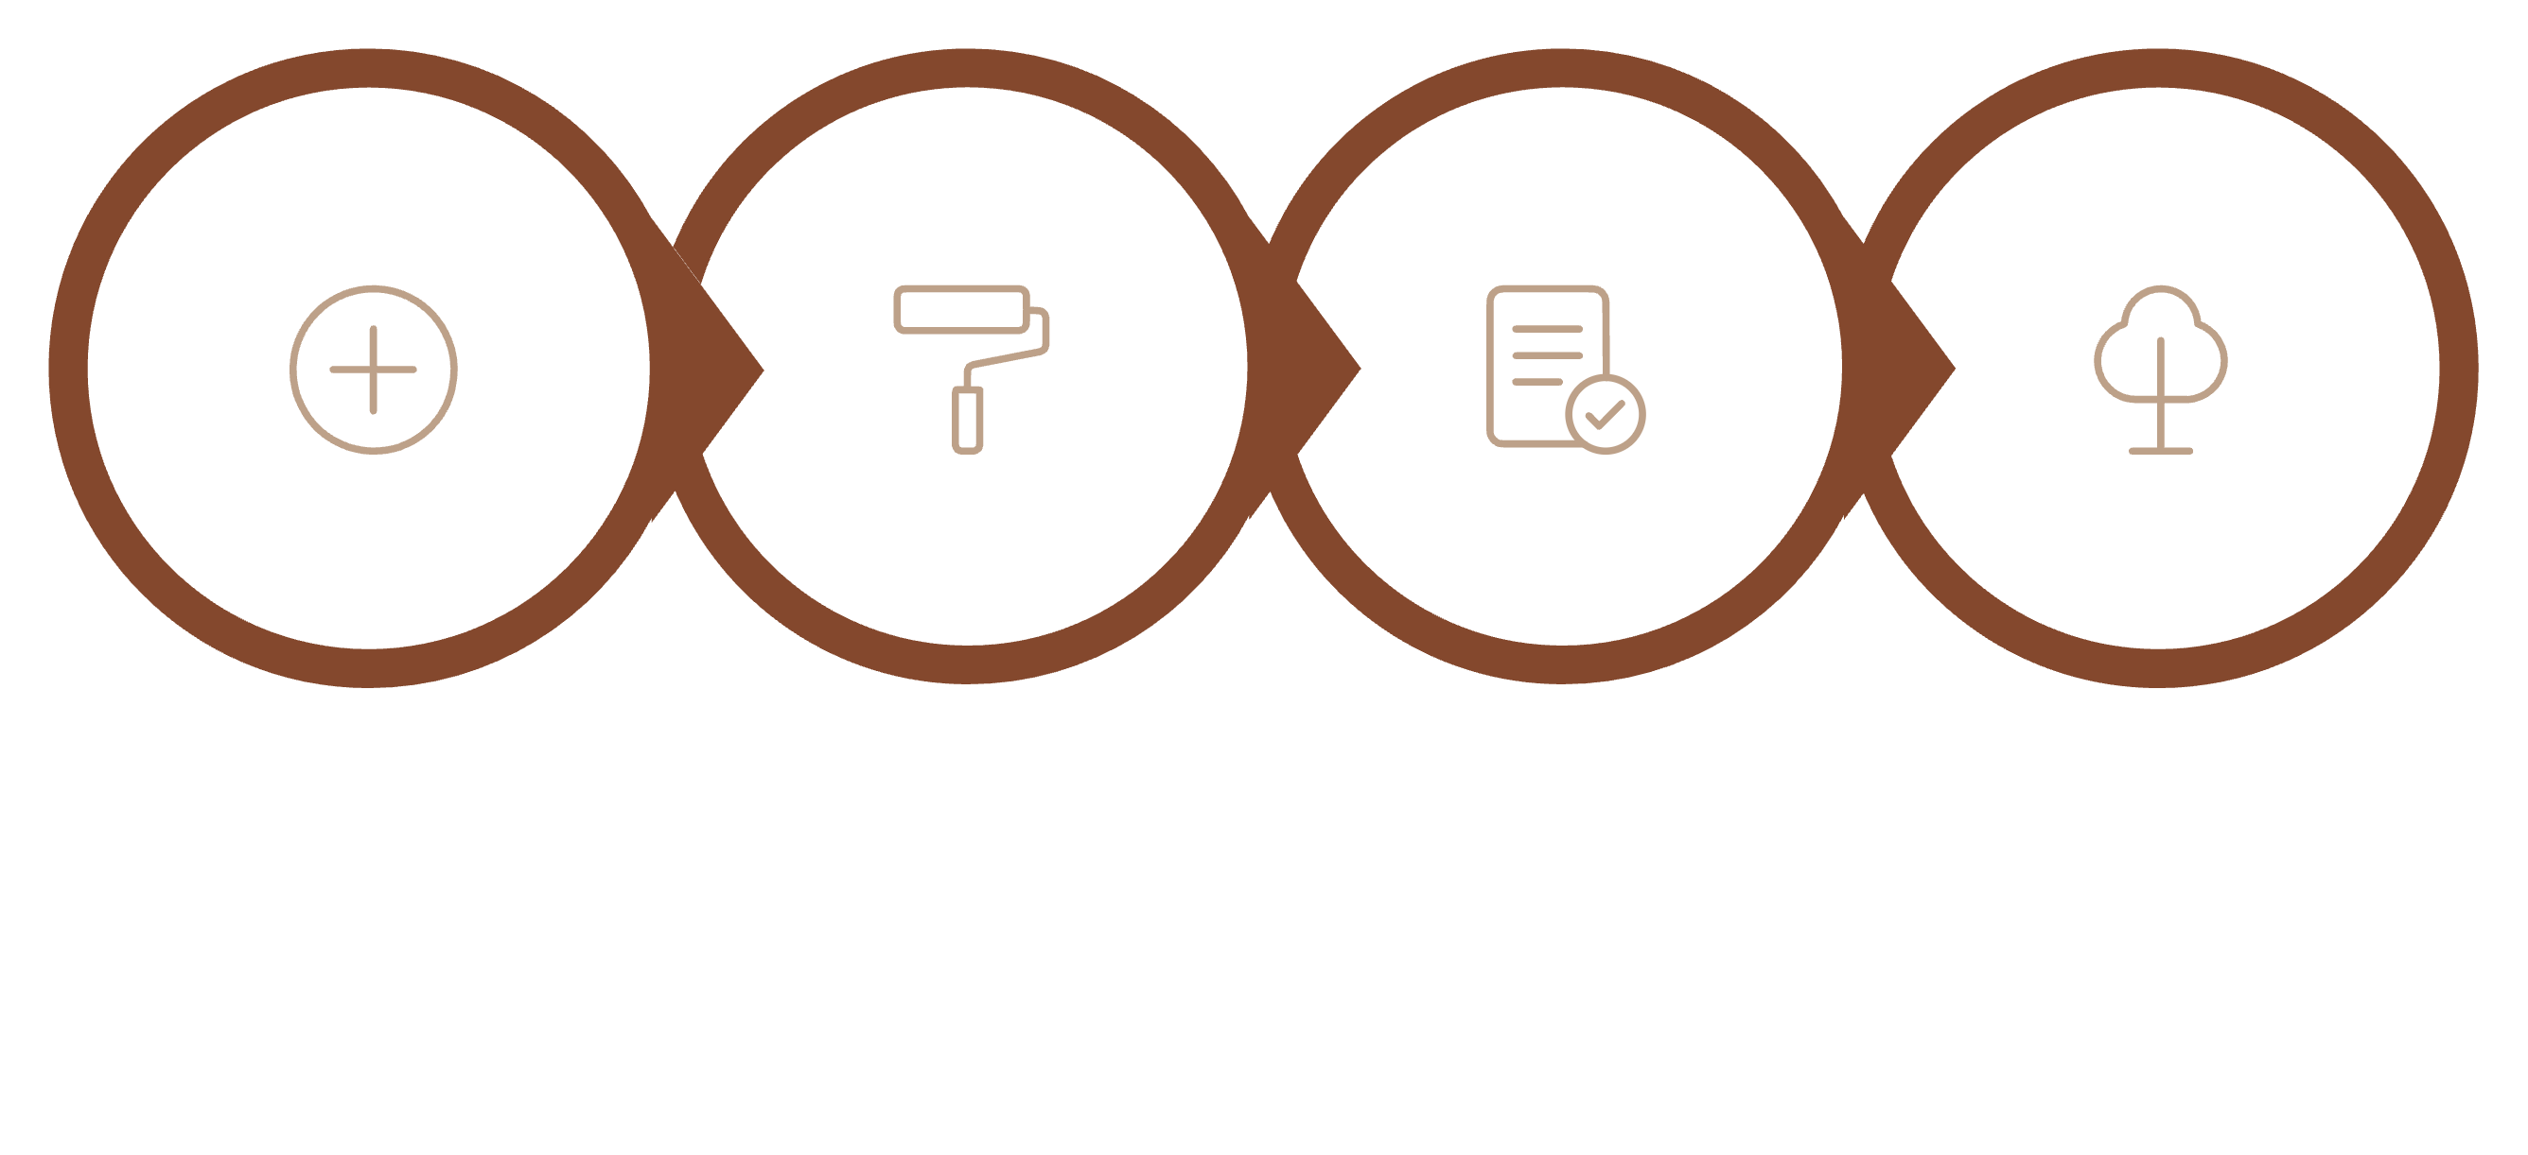




Insertion Process Diagram: Visualizing Balance
Understanding the rebalancing steps of insertion is critical. This diagram illustrates the key scenarios and transformations involved when a new red node is inserted into a Red-Black Tree.
Case 1 Recolor
Case 2 Rotate
Insert Red
Recolor Root
Each step involves checking the colors of the parent and uncle nodes. Depending on these colors, either a simple recoloring or a more complex series of rotations and recoloring is performed to restore the Red-Black Tree properties.

Slide 7

Thank You!

